Slide 1
Machine Learning in Reviewing Loan Applications
Yanchen Chen

Slide 2
Our Goal
Objective
Investigate financial meaningful and statistical significant variables that are determinant in loan default likelihood prediction using logistic regression, decision tree, and XGBoost
Expectation
Optimizing predictive reliability
using low computational cost model with public financial data

Slide 3
Baseline Model
Our Baseline
Logistics regression using public data
Industry | Our Model
High Accuracy Computational Expensive Professional Experience required | Easy Implementation Reasonable Computational Cost Feasible Interpretation Accessible Data

Slide 4
Statistical Prespective
Model | Logistic (Baseline) | Logistic (Threshold) | Decision Tree | XGBoost
Advantage |  | Determining Probability | Meaningful Interpretation | More Efficiency
Recall | 0.6403 | 0.9658 | 0.7819 | 0.8279
Accuracy | 0.6454 | 0.6003 | 0.6542 | 0.6061
4

Slide 5
Business Prespective
Target Client
Conservative Client: Model with high recall
Aggressive Client: Model with high accuracy = higher coverage of clients
Reasonable Computational Cost Model
Do not require advance coding skill
Do not require professional understanding of data science
Provide critical financial meaningful variables
Interest Rate
Annual Income
Loan Issue Date
Revolving Line Utilization Rate
Monthly Total Debt to Total Debt Obligation Ratio (DTI)
Total Credit Revolving Balance & Period Between Earliest Credit Line Date
Notes:
= lower coverage but better default prediction
= higher coverage of clients
by threshold in logistic and cutoff in random forest
based on loan amount: high, medium, and low amount

Slide 6
Data Processing
- Variable Overview
Factor predictor | Description
delinq_2yrs | The number of 30+ days past-due incidences of delinquency in the borrower's credit file for the past 2 years
home_ownership | The borrower’s home ownership status. (Rent, Own, Mortgage, Other)
verification_status | Indicates if income was verified or not. (Landing Club Verified, Verified Income Source, Not Verified)
purpose | A category provided by the borrower for the loan request.
Dependent Variable | Description
loan_status | Current status of the loan
Integer predictor | Description
collections_12_mths_ex_med | Number of collections in 12 months excluding medical collections
emp_length | Employment length in years
inq_last_6mths | The number of inquiries in past 6 months (excluding auto and mortgage inquiries)
loan_amnt | Amount of the loan applied by the borrower
open_acc | The number of open credit lines in the borrower's credit file
pub_rec | Number of derogatory public records
revol_bal | Total credit revolving balance
term | The number of payments on the loan
total_acc | The total number of credit lines currently in the borrower's credit file
credit_month | The time interval between the loan was funded and the borrower's earliest reported credit line was opened(round)
desc_len | the length of loan description provided by the borrower(in words)
Numerical predictor | Description
annual_inc | The self-reported annual income provided by the borrower during registration
dti | Monthly debt payments on the debt obligations, divided by monthly income.
Interest rate | Interest Rate on the loan
revol_util | The amount of credit the borrower is using relative to all available revolving credit
tot_coll_amt | Total collection amounts ever owed
Total current balance | Total current balance of all accounts
mths_since_last_delin | The number of months since the borrower's last delinquency
mth_since_last_derog | Months since most recent 90-day or worse rating
mth_since_last_record | The number of months since the last public record
6

Slide 7
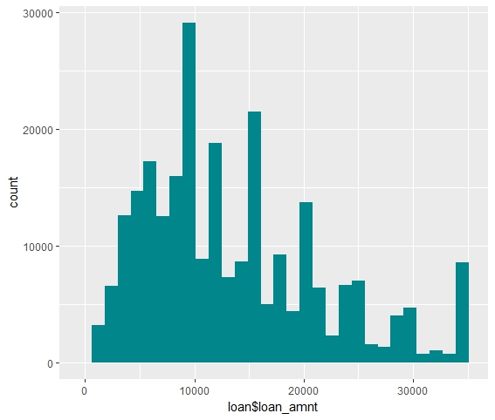
EDA - Variable Overview
Loan Amount
7

Slide 8
Data Understanding - Dataset Quality
Completeness
887,379 lines of loan records and 74 variables
Validity & Accuracy
From the lending company called Lending Club
Availability & Reliability
Online open source with reliable reputation
8

Slide 9
Data Cleaning
- Data preparation Tech & Other Key Task
Remove irrelevant variables according to financial definition
Response (Loan status)
Default & Charge off = 1
Fully Paid = 0
NA value - reassign as Infinity, mean, specified value
Outlier - none
Character - transform into factor levels
Date - transform into time
Divided into three subset - low, medium, high loan amount
9

Slide 10
Logistic regression - threshold & loan amount
 | Base Line | All Loan Amount | Low Loan Amount | Med Loan Amount | High Loan Amount
Accuracy | 0.6454 | 0.6024 | 0.6023 | 0.6010 | 0.6003
Recall | 0.6403 | 0.8927 | 0.7952 | 0.9014 | 0.9658
Threshold | 0.5 | 0.34 | 0.38 | 0.34 | 0.29
Value-add
By choosing different thresholds, recall increases up to 0.32.
By dividing data by loan amount, accuracy/recall increases.
10

Slide 11
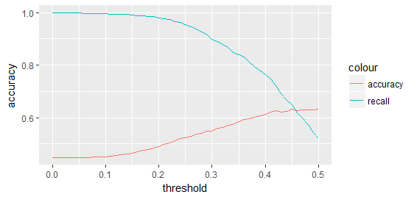
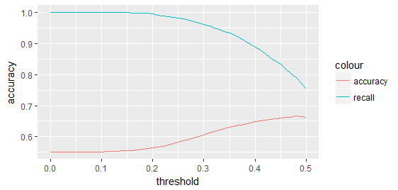
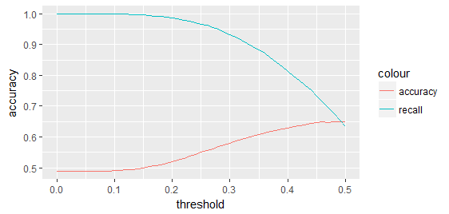

Logistic regression - Accuracy & recall trade off
Loan Amount = Low
Loan Amount = High
Loan Amount = Med
All Data
11

Slide 12
Logistic regression - loan amount
 | Base Line | All Loan Amount | Low Loan Amount | Med Loan Amount | High Loan Amount
Accuracy | 0.6454 | 0.6482 | 0.6255 | 0.6193 | 0.6003
Recall | 0.6403 | 0.7152 | 0.7218 | 0.8507 | 0.9658
Threshold | 0.5 | 0.46 | 0.42 | 0.38 | 0.29
Extra advantage
Flexible choices can be made according to different risk attitudes / strategies
12

Slide 13
Classification Tree
 | Base Line | All Loan Amount | Low Loan Amount | Med Loan Amount | High Loan Amount
Accuracy | 0.6454 | 0.5932 | 0.6086 | 0.6345 | 0.6542
Recall | 0.6403 | 0.7829 | 0.6471 | 0.7095 | 0.7819
Value-add
Increase recall by 0.14 only sacrificing accuracy by 0.05
Easy to visualize graphically
Closer to human decision-making
13

Slide 14
XGBoost
 | All Loan Amount | Low Loan Amount | Med Loan Amount | High Loan Amount
Accuracy | 0.5735 | 0.5934 | 0.6186 | 0.6234
Recall | 0.7341 | 0.4815 | 0.6161 | 0.6771
After splitting the dataset based on loan amount, accuracy increases as a trade off as recall
Target client: risk conservative companies
14

Slide 15
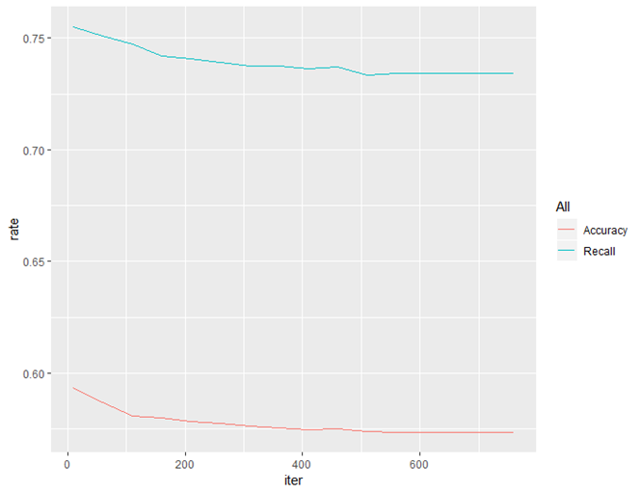
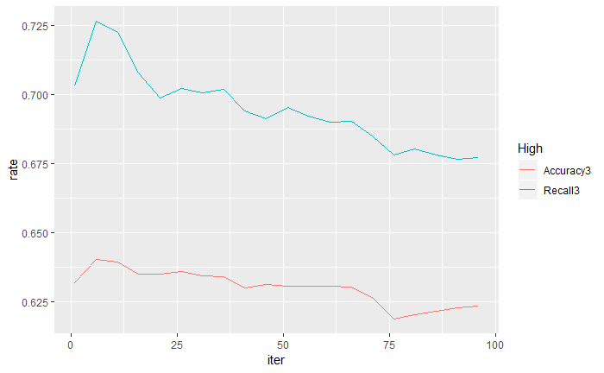
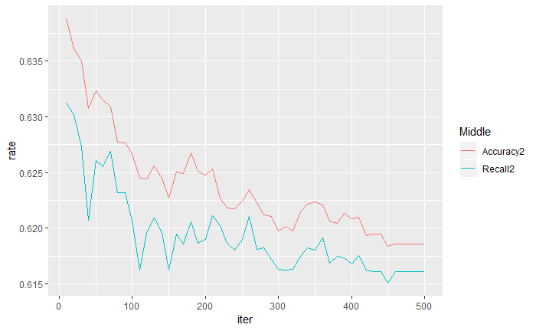
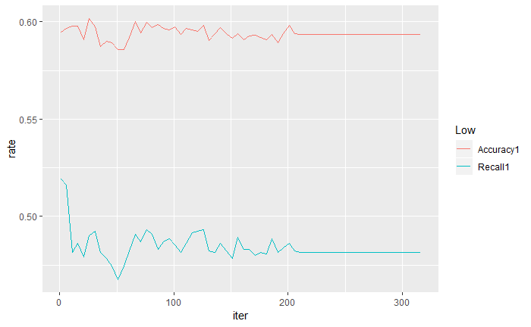
XGBoost
15

Slide 16
Variable Selection
Business understanding
Irrelevant variables
Pre-approval variables only
Financially intersect/overlap variables
Statistical meaning
Majority with missing value(NA)
Least importance
16

Slide 17
Workflow - Logistic Regression
The beginning
• Load training and out-of-sample datasets
Fit the logistic regression
• Use backwards stepwise for variable selection
• Set threshold value from 0 to 0.5, step by 0.01
Result
• Make prediction
• Calculate the accuracy rate and recall from the confusion matrix
• Plot accuracy and recall against different thresholds
17

Slide 18
Workflow - Decision Tree
The beginning
Load training and out-of-sample datasets
Grow the Tree
• Method as ‘class’
• Control with minsplit 20 and maxdepth 8
• Printcp display cp table
• Plotcp plot cross-validation results
• Select best cp value and grow the tree again
Result
• Make prediction using the new tree model
• Calculate the accuracy rate and recall from the confusion matrix
18
Notes:
Q1

Slide 19
Workflow - XGBoost
The beginning
Load training and out-of-sample datasets
XGBoost Algorithm
• Create a for loop iteration from 1 to 400+
• Implement XGBboost and ConfusionMatrix function
Result
• Make prediction
• Calculate the accuracy rate and recall from the confusion matrix
• Comparison plot
Notes:
Q1

Slide 20
THANKS!
Q&A

